Slide 1
IST 3420: Introduction to Data Science and Management
4. Cleansing and Manipulating Data

Slide 2
Agenda
Manipulate Strings
Manipulate Datasets
Create, Recode, and Rename Variables
Convert
Sort
Subset
Merge
Aggregate
Recode
Reshape

Slide 3
Reading Assignment
Read article “Introduction to String Matching and Modification in R Using Regular Expressions”
Download the article from Canvas

Slide 4
Data Management for Data Science
Our goal is to get prepared datasets that are ready for in-depth data analysis.
In R, the prepared datasets are usually data frames, which mimic the SAS or SPSS data set, i.e. a “cases by variables” matrix of data.

Slide 5

Why Data Management Matters?
Data cleansing/transformation is an essential (usually the most time-consuming) part of a data analytics project.
A properly prepared dataset is the prerequisite of statistical modeling, prediction, and inference.
The “Garbage in, garbage out” rule applies.
Image source: http://www.simplebi.com/wp-system1/uploads/2015/01/gigo.gif

Slide 6
Popular Data Manipulation Packages
dplyr
https://github.com/hadley/dplyr
https://cran.r-project.org/web/packages/dplyr/dplyr.pdf
tidyr
https://github.com/hadley/tidyr
https://cran.r-project.org/web/packages/tidyr/tidyr.pdf

Slide 7
Strings Manipulation

Slide 8
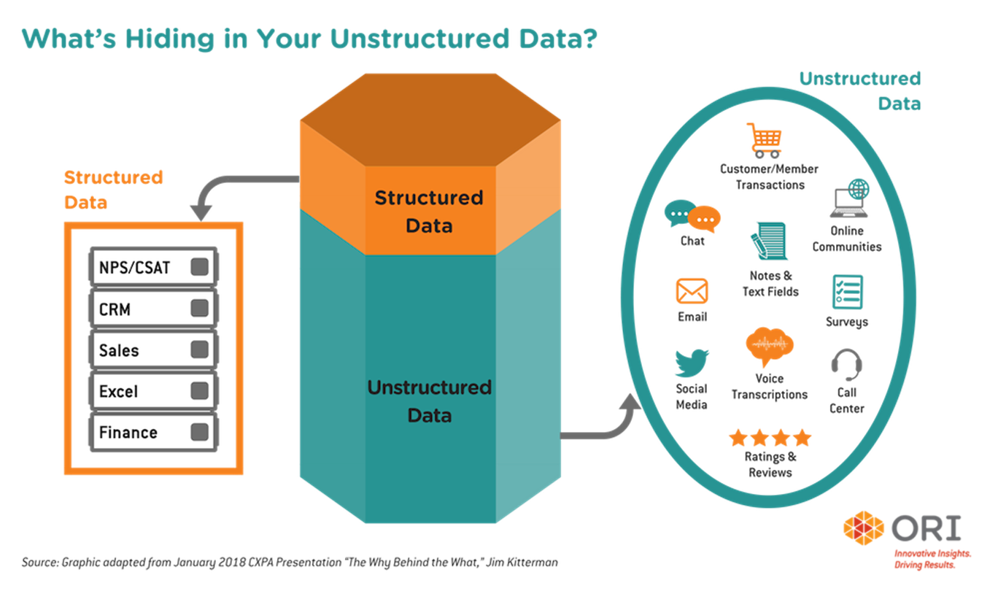
Why We Need String Manipulation?
Strings usually contain unstructured or semi-structured data
Regular expressions or regexps are a concise language for describing patterns in strings
find a word in a string
replace string
match a single character
match one of any of several letters
match series of range of characters

Slide 9
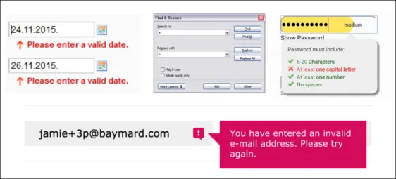
Use Cases of Regular Expressions
email validation
password validation
date validation
phone number validation
search and replace in text editors
web scraping

Slide 10
String Manipulation
General
tolower(): translate to lower case
toupper(): translate to upper case
nchar(): count the number of characters
trimws(): trim whitespace [ \t\r\n]
stringi::stri_reverse(): reverse a string
Pattern matching and replacement
grep(): detect patterns
regexpr(): locate patterns (find starting position and length of first match)
sub(): replace the first match
gsub(): replace all matches

Slide 11
(cont.)
Substrings
substr(x, start, stop)
substring(text, first, last = 1000000L)
Split Strings
strsplit(x, split, fixed = FALSE, perl = FALSE, useBytes = FALSE)
Concatenate
paste()
paste0()

Slide 12
Notes
To count the number of characters in a string, do NOT use length().
length() returns the length of the vector containing the string.
Instead, use nchar() function.
To find the position of matches in a string, do NOT use grep().
grep() returns the index of matched string in a vector, NOT the position of the match in the text.
Instead, use regexpr() to get the position of the 1st match, and use gregexpr() to get positions of all matches.

Slide 13
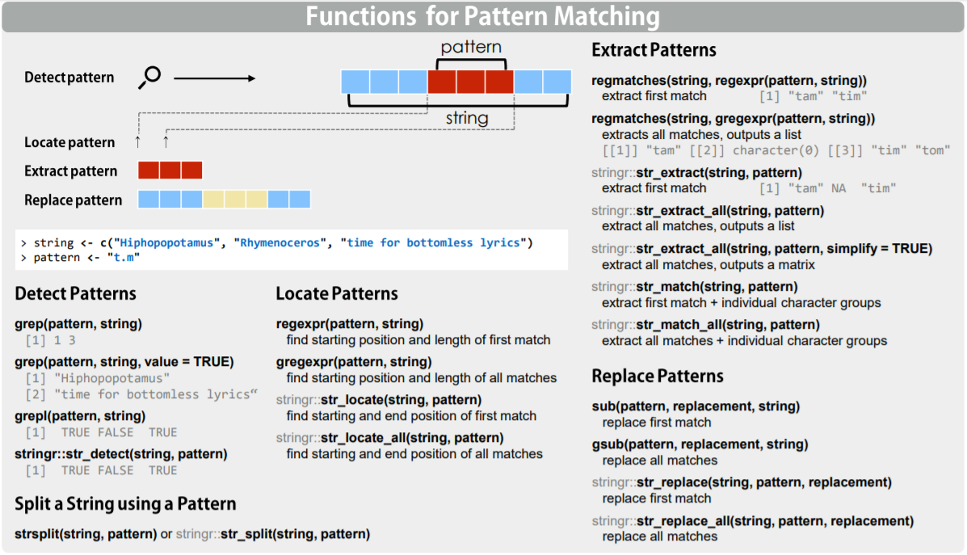
Which Method to Choose: Use Regex Cheat sheet
Image source: https://www.rstudio.com/wp-content/uploads/2016/09/RegExCheatsheet.pdf

Slide 14
R Code: String Manipulation
car <- rownames(mtcars)
tolower(car) # Translate to lower case
toupper(car) # Translate to upper case
nchar(car) # Count the number of characters
# Trim whitespace [ \t\r\n] (space, horizontal tab, line feed, carriage return)
trimws("\n Hello R! \t \r \n ")
# Reverse strings
stringi::stri_reverse("abcdef")
# Pattern matching and replacement
sub("a","1", "abcabcabc") # replace the first match
gsub("a","1", "abcabcabc") # replace all matches
gsub("[[:digit:]]","", "a1b2c3ef4gh55") # Remove all digits
# Substrings
substr("abcdef", 2, 5) # Syntax: substr(x, start, stop)
substring("abcdef", 2, 5) # Syntax: substring(text, first, last = 1000000L)
substring("abcdef", 1, 1:6)
substring("abcdef", 1:6, 1:6)

Slide 15
(cont.)
# Split strings
strsplit("abcdef", NULL) # Format: strsplit(x, split)
strsplit("a.b.c.d.e.f", "[.]") # split argument is a regular expression
strsplit("a.b.c.d.e.f", ".", fixed = TRUE) # Use exact matching
strsplit("12 23 14 21 56 78 99 "," ")
strsplit("12 23 14 21 56 78 99 ","[[:blank:]]+") # Match blank one or more times
unlist(strsplit("12 23 14 21 56 78 99 ","[[:blank:]]+")) # To get a vector
# Concatenate
paste("abc","123",sep = "")
paste("abc","123",sep = ",")
# paste0(...) is equivalent to paste(..., sep = ""), slightly more efficiently.
paste0("abc","123")

Slide 16
Think deeper about regex
Anchors: do not match any character but match the pattern supplied to a position before, after or between characters
Meta characters: special set of characters not captured by regular expressions, must be prefixed by double backslash (\\)
Quantifiers: act on items to the immediate left and are used to specify the number of times a pattern must appear or be matched
Character Classes: enclosed in a square bracket ([]), regex will match only those characters enclosed in the brackets and it matches only a single character
Source: https://www.r-bloggers.com/demystifying-regular-expressions-in-r/

Slide 17
Datasets Manipulation

Slide 18
Forward Pipe Operator magrittr::%>%
Pipe an object forward into a function or call expression.
Forward pipe operator makes R code more readable and elegant.
# compute the logarithm of `x`, return suitably lagged and iterated differences,
# compute the exponential function and round the result
x %>%
log() %>%
diff() %>%
exp() %>%
round(1)
round(exp(diff(log(x))), 1)

Slide 19
Syntax of magrittr::%>%
Syntax: lhs %>% rhs
lhs: left-hand side, rhs: right-hand side
Work with unary function calls:
x %>% f is equivalent to f(x)
Work with multi-argument function calls:
x %>% f(y) is equivalent to f(x, y)
y %>% f(x, ., z) is equivalent to f(x, y, z)
Use dot place-holder when lhs is not the first argument in rhs call.

Slide 20
R Code: Forward Pipe Operator
###### Pipe Operator magrittr::%>% ######
# Load magrittr package
library(magrittr)
# Learn about pipe operator%>%
?magrittr::`%>%`
# The pipe operator syntax is "lhs %>% rhs"
speed <- cars$speed
# Find the max speed
speed %>% max
# List unique speed values
speed %>% unique
# List unique speed values and sort them by descending order
speed %>% unique %>% sort(decreasing = TRUE)
# List top 5 speed values and sort them by descending order
speed %>% unique %>% sort(decreasing = TRUE) %>% head(5)
# When the lhs is not the first argument in rhs call, we can use the dot place-holder
"Ceci n'est pas une pipe" %>% gsub("une", "un", .)
sample(1:10) %>% paste0(LETTERS[.])

Slide 21
Manipulate Datasets
Create, Recode, and Rename Variables
Convert
Sort
Subset
Merge
Aggregate
Reshape

Slide 22
Create Variables
Use index ($ operator)
Use transform() function
Use dplyr::mutate() function

Slide 23
R Code: Create Variables
patient <- data.frame(id = c("A01","A02","A03"),
first.name = c("Mike","Emily","Hannah"),
last.name = c("Smith","Johson", "Williams"),
age = c(26,20,24),
mass = c(150, 120, 110),
height = c(70,68,67))
patient
## Use Base R Feature ##
# Use index
patient2 <- patient # Copy the original dataset
# Add new variable full.name
patient2$full.name <- paste(patient2$first.name,patient2$last.name,sep = " ")
# Add new variable bmi
patient2$bmi <- 703*patient2$mass/(patient2$height^2)
patient2
# Use transform()
patient3 <- transform(patient,
full.name = paste(first.name,last.name,sep = " "),
bmi = 703*mass/(height^2))
patient3
## Use dplyr::mutate() ##
patient4 <- dplyr::mutate(patient,
full.name = paste(first.name,last.name,sep = " "),
bmi = 703*mass/(height^2))
patient4

Slide 24
Recode Variables
Recode the values of variables usually involves applying conditions.
###### Recode Variables ######
patient4$bmi.category[patient4$bmi>=16 & patient4$bmi<18.5] <- "Underweight"
patient4$bmi.category[patient4$bmi>=18.5 & patient4$bmi<25] <- "Normal"
patient4$age.group = ifelse(patient4$age>=25,"Older","Younger")
patient4
# Recode the ID
patient4$id <- dplyr::recode(patient4$id,A01 = "B01", A02 = "B02", A03 = "B03")
# Recode the age
patient4$age <- dplyr::recode(patient4$age,`26` = 27L,`20` = 21L,`24` = 25L)
patient4

Slide 25
Rename Variables
###### Rename Variables ######
names(patient4)[names(patient4) == "bmi.category"] <- "health.status“
patient4 <- dplyr::rename(patient4,weight = mass) # Rename mass as weight
patient4

Slide 26
Manipulate Datasets
Create, Recode, and Rename Variables
Convert
Sort
Subset
Merge
Aggregate
Reshape

Slide 27
Data Conversion
Basic Data Structure Conversion Functions
 | To Data Type
From Data Type |  | Long Vector | Matrix | Data Frame
 | Vector | c(x,y) | cbin(x,y), rbin(x,y) | data.frame(x,y)
 | Matrix | as.vector() |  | as.data.frame()
 | Data Frame |  | as.matrix()
Source: http://www.statmethods.net/management/typeconversion.html

Slide 28
Data Conversion
Convert factor to numeric: as.numeric(as.character(x))
# Read the dataset we collected from https://nrf.com/2015/top100-table
df <- read.csv("top100retailers2015.csv")
# Show the structure of the dataset
str(df) # All variables except the first two are factor data (i.e., nominal scale)
summary(df) # Cannot get summary statistics such as min, max etc. for nominal data
df$RetailSales2014 <- df$RetailSales2014 %>%
gsub(",","",.) %>%
gsub("$","",.,fixed = TRUE) %>%
as.character() %>%
as.numeric()
# Show the structure of the new variable
str(df$RetailSales2014)
# Get summary statistics of the new variable
summary(df$RetailSales2014)

Slide 29
Manipulate Datasets
Create, Recode, and Rename Variables
Convert
Sort
Subset
Merge
Aggregate
Reshape

Slide 30
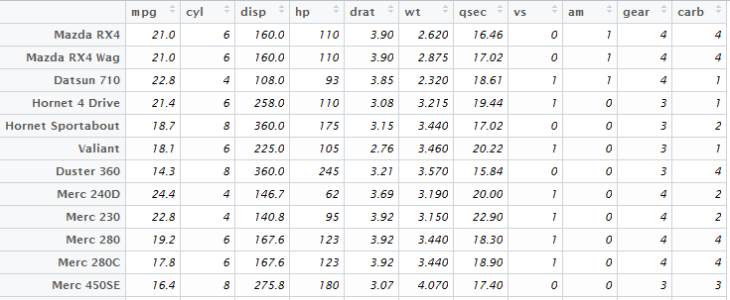
Sort
To sort data frames into ascending or descending order along one or more variables
Why is sorting important?
If I care much about mpg, which cars should I choose?

Slide 31
Sorting Methods
Two general methods
Use order() function in base R
Use arrange() function in dplyr package

Slide 32
R Code: Sort Data
## Use base R features
# Sort by mpg (ascending)
mtcars[order(mtcars$mpg),]
# Sort by cyl (ascending) and hp (ascending)
mtcars[order(mtcars$cyl, mtcars$hp),]
# Sort by cyl (ascending) and hp (descending)
mtcars[order(mtcars$cyl, -mtcars$hp),]
## Use arrange() in dplyr package
# Sort by mpg (ascending)
dplyr::arrange(mtcars,mpg)
# Sort by cyl (ascending) and hp (ascending)
dplyr::arrange(mtcars,cyl,hp)
# Sort by cyl (ascending) and hp (descending)
dplyr::arrange(mtcars,cyl,desc(hp))

Slide 33
Manipulate Datasets
Create, Recode, and Rename Variables
Convert
Sort
Subset
Merge
Aggregate
Reshape

Slide 34
Subset
Subset variables
Subset observations

Slide 35
Subset Methods
Use base R features
Use index
Use which() function
Use subset() function
Use dplyr package
Use dplyr::select() to select variables
Use dplyr::filter() to select observations

Slide 36
R Code: Use Base R Index Feature
data(mtcars) # Load the built-in dataset mtcars
str(mtcars) # Show the structure
# Use index to select variables
car1 <- mtcars[c("mpg","wt")] # Select miles per gallon and weight
names(car1)
car2 <- mtcars[c(1,6)] # Select 1st and 6th variables, i.e. mpg and wt
names(car2)
car3 <- mtcars[c(1:5,10)] # Select 1st through 5th and 10th variables
names(car3)
car4 <- mtcars[c(-3,-5)] # Exclude the 3rd and 5th variables
names(car4)
# Use index and which() to select observations
car5 <- mtcars[1:4,] # First 4 observations
car6 <- mtcars[which(mtcars$mpg >= 25),] # Select cars whose mpg >= 25
car6
car7 <- mtcars[which(mtcars$mpg >= 25 & mtcars$gear == 4),] # Select cars whose mpg >= 25 and gear == 4
car7
# Use index and which() to select both observations and variables
car8 <- mtcars[which(mtcars$mpg >= 25),c("mpg", "wt")] # Select mpg and wt variables with mpg >= 25
car8

Slide 37
R Code: Use Base R subset() Function
# Use subset() function to select both observations and variables
car11 <- subset(mtcars, select = c("mpg","wt")) # Select mpg and wt variables
names(car11)
car12 <- subset(mtcars, select = c(1,6))
names(car12)
car13 <- subset(mtcars, select = mpg:wt) # Select all variables between mpg and wt
names(car13)
car14 <- subset(mtcars,mpg >= 25,select = c(mpg,wt)) # Select mpg and wt variables with mpg >= 25
car14
car15 <- subset(mtcars,cyl == 6,select = c(1:6)) # Select 1st through 6th variables with cyl == 6
car15

Slide 38
R Code: Use dplyr Package
## Use dplyr package
library(dplyr)
# Use dplyr::select() to select variables
car21 <- select(mtcars,c(mpg,wt)) # Select mpg and wt variables
names(car21)
car22 <- select(mtcars,-c(mpg,wt)) # Select variables except mpg and wt
names(car22)
car23 <- select(mtcars,contains("p")) # Select variables containing "p"
names(car23)
# Use dplyr::filter() to select observations
filter(mtcars,mpg >= 25) # Select cars with mpg >= 25
filter(mtcars,mpg >= 25 & gear == 4) # Select cars with mpg >= 25 and gear == 4
# Combine dplyr::select() and dplyr::filter()
select(filter(mtcars,mpg >= 25),c(mpg,wt)) # Select mpg and wt variables with mpg >= 25
filter(select(mtcars,c(mpg,wt)),mpg >= 25) # Another way

Slide 39
Manipulate Datasets
Create, Recode, and Rename Variables
Convert
Sort
Subset
Merge
Aggregate
Reshape

Slide 40
Merge/Join Data Frames
4 Major Types of Merging/Joining x and y
Inner join:
Only rows with matching keys in both x and y
Left outer join
All rows in x, adding matching columns from y
Right outer join
All rows in y, adding matching columns from x
Full outer join
All rows in x with matching columns in y, then the rows of y that don't match x.

Slide 41
Examples
Enrollment
CourseID | StudentID
IST3420 | 201
IST3420 | 202
IST3420 | 501
Student
StudentID | Name | Department
201 | Mike | IST
202 | Emily | BUS
203 | Hannah | IST
Enrollment.StudentID = Student.StudentID
Inner Join
CourseID | StudentID | Name | Department
IST3420 | 201 | Mike | IST
IST3420 | 202 | Emily | BUS
Left Outer Join
CourseID | StudentID | Name | Department
IST3420 | 201 | Mike | IST
IST3420 | 202 | Emily | BUS
IST3420 | 501
Right Outer Join
CourseID | StudentID | Name | Department
IST3420 | 201 | Mike | IST
IST3420 | 202 | Emily | BUS
 | 203 | Hannah | IST
Full Outer Join
CourseID | StudentID | Name | Department
IST3420 | 201 | Mike | IST
IST3420 | 202 | Emily | BUS
IST3420 | 501
 | 203 | Hannah | IST

Slide 42
Merge/Join Methods
Use merge() function
Use join() function in plyr package
Use dplyr package
inner_join()
left_join()
right_join()
full_join()

Slide 43
R Code: Use merge() Function
enrollment <- data.frame(courseId = "IST3420",
studentId = c("201","202","501"))
student <- data.frame(studentId = c("201","202","203"),
name = c("Mike","Emily","Hannah"),
department = c("IST","BUS","IST"))
print(enrollment)
print(student)
# Inner join
merge(x = enrollment, y = student, by = "studentId")
# Left outer join
merge(x = enrollment, y = student, by = "studentId", all.x = TRUE)
# Right outer join
merge(x = enrollment, y = student, by = "studentId", all.y = TRUE)
# Full outer join
merge(x = enrollment, y = student, by = "studentId", all = TRUE)

Slide 44
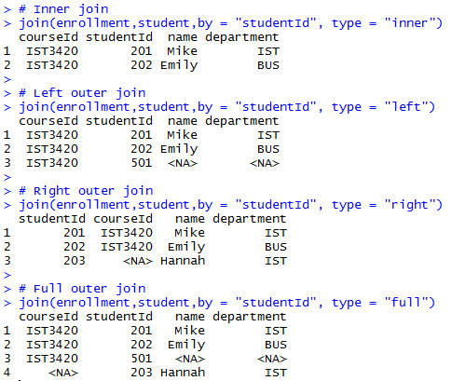
R Code: Use join() Function in plyr Package
# install.packages("plyr")
library("plyr")
print(enrollment)
print(student)
# Inner join
join(enrollment,student,by = "studentId", type = "inner")
# Left outer join
join(enrollment,student,by = "studentId", type = "left")
# Right outer join
join(enrollment,student,by = "studentId", type = "right")
# Full outer join
join(enrollment,student,by = "studentId", type = "full")

Slide 45
R Code: Use dplyr Package
# install.packages("dplyr")
library("dplyr")
# Inner join
inner_join(enrollment,student,by = "studentId") # This does not work
# Show the structure of data frames
str(enrollment)
str(student)
# Change vectors from factor type to character type
enrollment$courseId <- as.character(enrollment$courseId)
enrollment$studentId <- as.character(enrollment$studentId)
student$studentId <- as.character(student$studentId)
student$name <- as.character(student$name)
student$department <- as.character(student$department)
str(enrollment)
str(student)
inner_join(enrollment,student,by = "studentId") # Now it works
# Left outer join
left_join(enrollment,student,by = "studentId")
# Right outer join
right_join(enrollment,student,by = "studentId")
# Full outer join
full_join(enrollment,student,by = "studentId")

Slide 46
Manipulate Datasets
Create, Recode, and Rename Variables
Convert
Sort
Subset
Merge
Aggregate
Reshape

Slide 47
Aggregate
Base R
aggregate(): group data and calculate summary statistics
dplyr Package
group_by(): group data
summarize(): calculate summary statistics

Slide 48
R Code: Aggregate
###### Aggregate ######
library(dplyr)
attach(mtcars)
mtcars %>% head
# Use aggregate() function
mtcars %>% aggregate(by=list(cyl,vs),FUN=mean, na.rm=TRUE)
# Use dplyr::group_by() and dplyr::summarize() functions
mtcars %>% group_by(cyl,vs) %>%
summarize(mean(mpg),mean(disp),mean(hp),mean(drat),mean(wt),mean(qsec),mean(am),mean(gear),mean(carb))
# Aggregate by cyl and vs, show mean of mpg for each group
mtcars %>% group_by(cyl,vs) %>% summarize(mean(mpg))
# Aggregate by cyl and vs, show maximum mpg for each group
mtcars %>% group_by(cyl,vs) %>% summarize(max(mpg))
detach(mtcars)

Slide 49
Manipulate Datasets
Create, Recode, and Rename Variables
Convert
Sort
Subset
Merge
Aggregate
Reshape

Slide 50

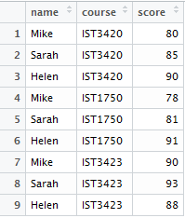
Reshape: Change the Layout of a Data Set
Use tidyr Package
gather(data, key, value, …): to gather columns into rows
spread(data, key, value): to spread rows into columns
wide format
long format
gather
spread

Slide 51
R Code: Reshape
###### Reshape ######
library(tidyr)
# A student score dataset in wide format
score_wide <- data.frame(
name = c("Mike","Sarah","Helen"),
IST3420 = c(80,85,90),
IST1750 = c(78,81,91),
IST3423 = c(90,93,88)
)
print(score_wide)
## Gather columns into key-value pairs
score_long <- score_wide %>% gather(course,score,IST3420, IST1750,IST3423)
print(score_long)
# Another way to specify columns to gather
score_wide %>% gather(course,score,c(IST3420, IST1750,IST3423))
# Still another way to specify columns to gather
score_wide %>% gather(course,score,-name)
## Split a single character column into multiple columns
print(score_long)
score_long %>% spread(course,score)

Slide 52
Reference
Data Transformation with dplyr Cheatsheet
https://github.com/rstudio/cheatsheets/raw/master/source/pdfs/data-transformation-cheatsheet.pdf

Slide 53
Data Manipulation in a Project
Weblog Analytics

Slide 54
Business Scenario
Company XYZ runs a website. The company is confronting the challenge of extracting information and knowledge from this website to better understand how visitors access the online service.
The objective of this data analytics project is to answer the following questions:
What are the top 10 countries from which the visitors come?
How many visits do we have for the FAQ page?
More……

Slide 55

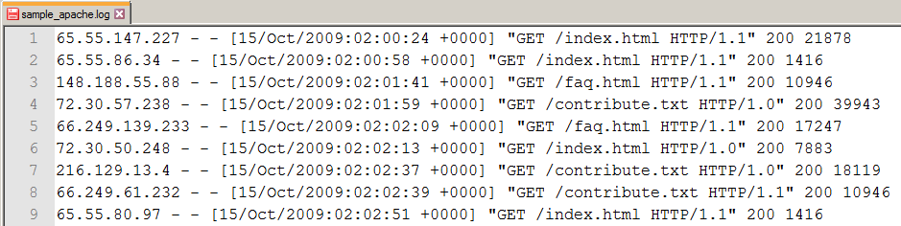
Apache Web Server Log
The log file records all HTTP requests from browser clients to web server.
Remote host
Request time
Request method
Request URI
Request protocol
Status
Size of request

Slide 56
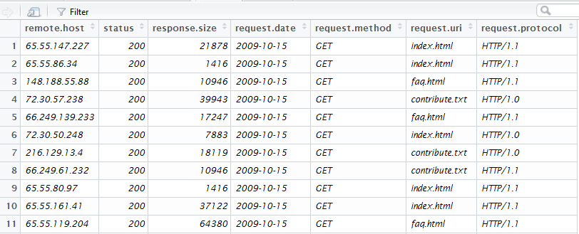
Data Management Task
Import the Apache log file
Cleanse and transform the data into the following data frame

Slide 57
Data Management Task
Convert IP address to IP number
Refer to http://www.ip2country.net/ip2country/ip_number.html
IP Number = 16777216*w + 65536*x + 256*y + z (1)
Where IP Address = w.x.y.z
For example, if IP address is "169.6.7.20", then its IP Number "2835744532" is based on formula (1).
IP Number = 16777216*169 + 65536*6 + 256*7 + 20
= 2835349504 + 393216 + 1792 + 20
= 2835744532
“GeoLite Country” database: https://dev.maxmind.com/geoip/geoip2/geolite2/
“rgeolocat” package:
https://cran.r-project.org/web/packages/rgeolocate/index.html

Slide 58

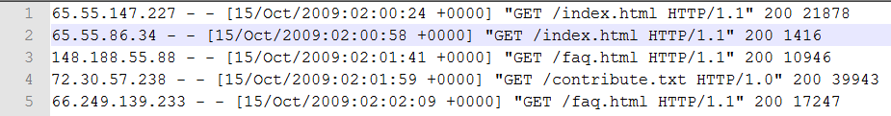
Web Analytics Summary
Common reasons to use web analytics
Understand website traffic
Track mass user activity
Improve site design and user experience
Two common data sources
Web server log files (e.g., Apache log file)
Page tagging or “Web bugs” (e.g., analytics.js)
<!-- Google Analytics --> <script> (function(i,s,o,g,r,a,m){i['GoogleAnalyticsObject']=r;i[r]=i[r]||function(){ (i[r].q=i[r].q||[]).push(arguments)},i[r].l=1*new Date();a=s.createElement(o), m=s.getElementsByTagName(o)[0];a.async=1;a.src=g;m.parentNode.insertBefore(a,m) })(window,document,'script','//www.google-analytics.com/analytics.js','ga');
ga('create', 'UA-XXXXX-Y', 'auto'); ga('send', 'pageview'); </script> <!-- End Google Analytics -->
Notes:
https://developers.google.com/analytics/devguides/collection/analyticsjs/
The analytics.js library is a JavaScript library for measuring how users interact with your website.
Adding the following code (known as the "JavaScript tracking snippet") to your site's templates is the easiest way to get started using analytics.js.
What data does the tracking snippet capture?
The total time a user spends on your site.
The time a user spends on each page and in what order those pages were visited.
What internal links were clicked (based on the URL of the next pageview).
In addition, the IP address, user agent string, and initial page inspection analytics.js does when creating a new tracker is used to determine things like the following:
The geographic location of the user.
What browser and operating system are being used.
Screen size and whether Flash or Java is installed.
The referring site.

Slide 59
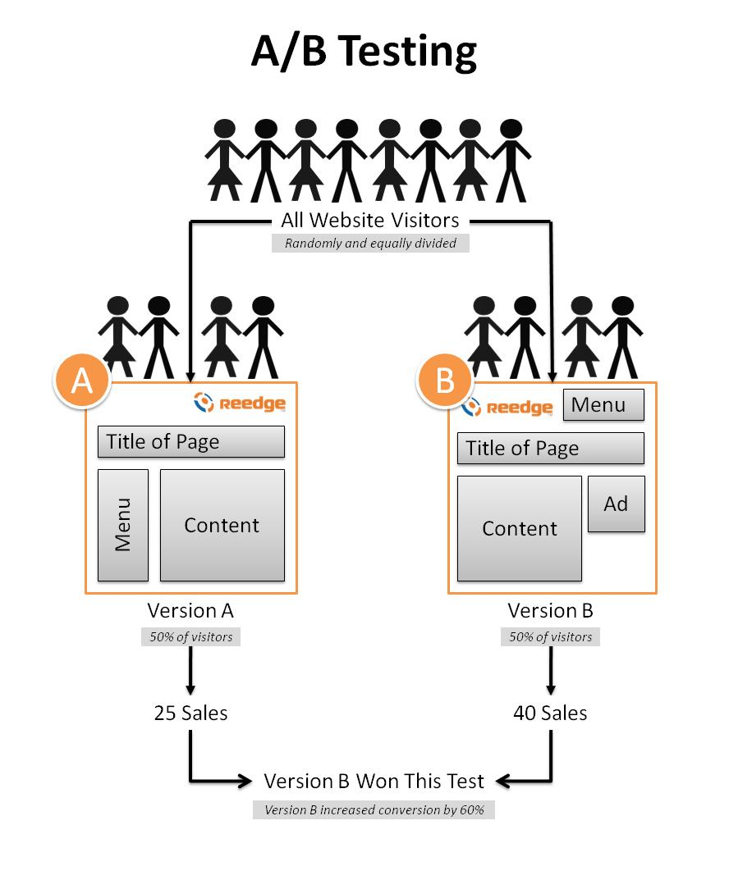
Web Analytics - Field Experiment
https://receiptful.com/blog/ab-testing-for-ecommerce/
Notes:
With the powerful tool of web analytics, we can also conduct field experiment to test our hypothesis regarding product design, user experience, marketing campaign etc.
For example, we can easily do the so called “A/B testing”.

Slide 60
R Code
Refer to “Manage_Weblog_Data.Rmd”

Slide 61
Q & A

